Slide 1
Functional Programming in
Javascript
Yoav Rubin
@yoavrubin

Slide 2
Today
About functional programming
A little about Javascript
Deep dive into the combination of the two
  Inner functions and closures
  Higher order functions
  Decomplecting calls patterns

Slide 3
What will you gain?
Inner functions and closures
  Improving performance via memoization
  A different perspective on objects
Higher order functions
  Avoiding mistakes due to the leaky abstraction of arrays
  Composing functions from functions
Decomplecting calls patterns
  Regaining the ability to use recursion
  A look behind the scenes of streams

Slide 4
Today
About functional programming
A little about Javascript
Deep dive into the combination of the two
  Inner functions and closures
  Higher order functions
  Decomplecting calls patterns

Slide 5
Today
About functional programming
A little about Javascript
Deep dive into the combination of the two
  Inner functions and closures
  Higher order functions
  Decomplecting calls patterns

Slide 6
About functional programming
All agree – it’s a programming paradigm
There’s no agreed upon definition
  See Gilad Bracha’s talk: http://www.infoq.com/presentations/functional-pros-cons

Slide 7
My definition
Thinking the software using data and functions
  Analysis, modeling
Data and functions focused development
  Rather than classes and mutable object state
Core ideas
  Data is immutable
  Functions are first class citizens

Slide 8
Why functional programming
Higher level of programming
  Faster to develop
  Simpler to test
A good software person should know more then one paradigm
  Because problems are getting tougher
MUST

Slide 9
Today
About functional programming
A little about Javascript
Deep dive into the combination of the two
  Inner functions and closures
  Higher order functions
  Decomplecting calls patterns

Slide 10
About functional programming
A little about Javascript
Deep dive into the combination of the two
  Inner functions and closures
  Higher order functions
  Decomplecting calls patterns

Slide 11
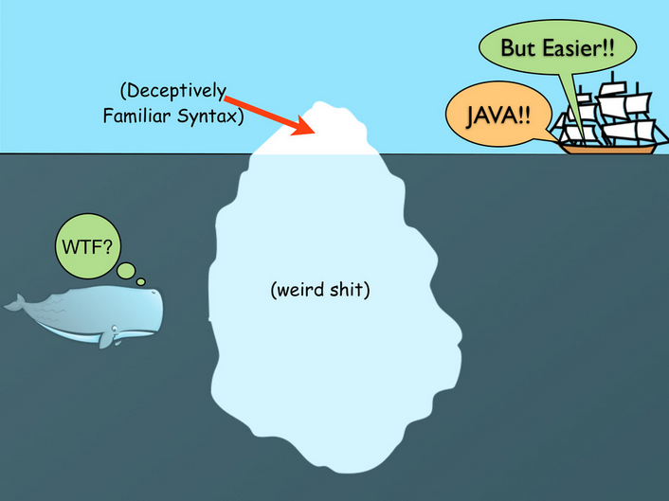
A little about Javascript

Slide 12
Objects are maps
An object is a set of key-value pairs
Values can be anything and may change
Pairs can be added and removed

Slide 13
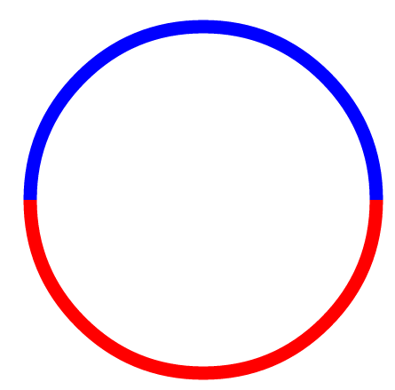
key2
value2
key3
key1
value3
value1
{ }
{ }
{ }
key4
key6
key5

Slide 14
key2
value2
key3
key1
value3
value1
Keys whose values are members
{ }
{ }
{ }
key4
key6
key5

Slide 15
key2
value2
key3
key1
value3
value1
Keys whose values are methods
{ }
{ }
{ }
key4
key6
key5

Slide 16
Arrays
Arrays are objects are maps
Fields whose keys are integers gain “special treatment”

Slide 17
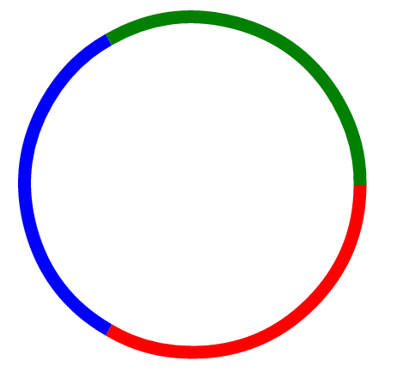
Integer key1
value3
Integer key2
key1
value4
Integer key3
value1
value5
key2
value2
{ }
{ }
key4
key3

Slide 18
Integer key1
value3
Integer key2
key1
value4
Integer key3
value1
value5
key2
value2
{ }
{ }
Fields whose values are members
key4
key3

Slide 19
Integer key1
value3
Integer key2
key1
value4
Integer key3
value1
value5
key2
value2
{ }
{ }
Fields whose values are methods
key4
key3

Slide 20
Integer key1
value3
Integer key2
key1
value4
Integer key3
value1
value5
Fields whose keys are integers
key2
value2
{ }
{ }
key4
key3

Slide 21
Functions
Functions are objects are maps
Can also be executed

Slide 22
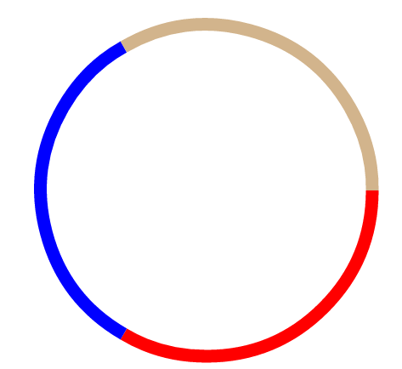
Fields whose keys are members
(…)
key1
{…}
value1
key2
value2
{ }
{ }
key4
key3

Slide 23
(…)
key1
{…}
value1
key2
value2
{ }
{ }
Fields whose values are methods
key4
key3

Slide 24
(…)
key1
{…}
value1
What gets executed
key2
value2
{ }
{ }
key4
key3

Slide 25
Functions are objects
Can be defined anywhere
Can be assigned to a variable
  Or act as a value in an object (or in an array)
Can be sent as an argument to a function
Can be returned as a return value from a function

Slide 26
Today
About functional programming
A little about Javascript
Deep dive into the combination of the two
  Inner functions and closures
  Higher order functions
  Decomplecting calls patterns

Slide 27
A little about functional programming
Alittle about Javascript
Deep dive into the combination of the two
  Inner functions and closures
  Higher order functions and arrays
  Patterns

Slide 28
Inner functions and closures
A function can be defined inside another function
The inner function can access anything found at the outer function

Slide 29
Recursive Fibonacci
function fib(n){
if (n < 2)
return n;
return fib(n-1) + fib(n-2);
}
fib(10) results in 177 calls to fib
(time complexity - O(2^{n}) )

Slide 30
Fibonacci using inner function
function fastFib(n){
var memo = [0,1];
var fib = function(n){
var result = memo[n];
if(result !== undefined) return result;
result = fib(n-1) + fib(n-2);
memo[n] = result;
return result;
}
return fib(n);
}
fastFib(10) results in 19 calls to the fib function (time complexity - O(n))
An inner function

Slide 31
FastFib
Memo
The Fib function
Calculate if value is not in the cache
Maintain the cache
This pattern is nicknamed memoization

Slide 32
Closure
Computation done in an inner function can access data found in the outer function
Such an access creates a construct called closure

Slide 33
Closures remain alive even when the execution of the outer function was finished

Slide 34
Fibonacci using closure
function fastFibMaker(){
var memo = [0,1];
var fib = function(n){
var result = memo[n];
if (result !== undefined) return result;
result = fib(n-1) + fib(n-2);
memo[n] = result;
return result;
}
return fib;
}
var theFib = fastFibMaker(); // returns a function
theFib (10); // 19 calls to fib
theFib (10); // 1 call to fib

Slide 35
FastFibMaker
memo
Fib

Slide 36
FastFibMaker
memo
var fastFib
Fib

Slide 37
(…)
X=…
Y=…
{…}
key1
value1
What gets executed
key2
value2
{ }
{ }
key4
key3

Slide 38
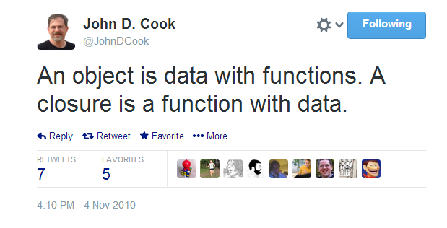

Slide 39
Today
About functional programming
A little about Javascript
Deep dive into the combination of the two
  Inner functions and closures
  Higher order functions
  Decomplecting calls patterns

Slide 40
Today
A little about functional programming
A little about Javascript
Deep dive into the combination of the two
  Inner functions and closures
  Higher order functions
  Patterns

Slide 41
Higher order functions
Receive function, return value
Receive value, return function

Slide 42
Higher order functions
Receive function, return value
Receive value, return function

Slide 43
Receive function, return value
The receiving function provides the syntactic skeleton of the computation
The sent function provides the semantics for the calculation
Implementation of the “Strategy design pattern”

Slide 44
Where do we see it?

Slide 45
Working with arrays
One of the most common things we do in code
Especially, in conjunction with looping
The common looping patterns have equivalent higher order methods in arrays

Slide 46
Building a value out of an array
var i, res = seed;
for (i=0 ; i<arr.length ;i ++)
res = someFunc(res, arr[i]);

Slide 47
Building a value out of an array
var i, res = seed;
for (i=0 ; i<arr.length ;i ++)
res = someFunc(res, arr[i]);
This is just the same as
res = arr.reduce(someFunc, seed);

Slide 48
Creating an array out of an array
var i, res = [];
for (i=0 ; i<arr.length ;i ++)
res.push(someFunc(arr[i]));

Slide 49
Creating an array out of an array
var i, res = [];
for (i=0 ; i<arr.length ;i ++)
res.push(someFunc(arr[i]));
This is just the same as
res = arr.map(someFunc);

Slide 50
Selecting items from an array
var i, res = [];
for (i=0 ; i<arr.length ;i ++){
if (pred(arr[i]))
res.push(arr[i]);
}
This is just the same as
res = arr.filter(someFunc);

Slide 51
Selecting items from an array
var i, res = [];
for (i=0 ; i<arr.length ;i ++){
if (pred(arr[i]))
res.push(arr[i]);
}
This is just the same as
res = arr.filter(pred);

Slide 52
Few more variations
Array.forEach(someFunc)
  To execute someFunc on every item in the array
Array.some(predFunc)
  Checks whether at least one of the elements of the array fulfils predFunc
Array.every(predFunc)
  Checks whether all of the elements of the array fulfils predFunc

Slide 53
And combination of these
  var i, tmp, res = seed;
  for(i=0;i<arr.length;i++){
  if(pred(arr[i])){
  tmp = mapFn(arr[i]);
  res = redFn(res, tmp);
  }
  }
var res = arr.filter(pred).map(mapFn).reduce(redFunc);

Slide 54
And combination of these
  var i, tmp, res = seed;
  for(i=0;i<arr.length;i++){
  if(pred(arr[i])){
  tmp = mapFn(arr[i]);
  res = redFn(res, tmp);
  }
  }
var res = arr.filter(pred).map(mapFn).reduce(redFn, seed);

Slide 55
Boilerplatting
  var i, tmp, res = seed;
  for(i=0;i<arr.length;i++){
  if(pred(arr[i])){
  tmp = mapFn(arr[i]);
  res = redFn(res, tmp);
  }
  }
var res = arr.filter(pred).map(mapFn).reduce(redFn, seed);
That’s just boilerplate code !!!

Slide 56
What can bite you here?
  var i, tmp, res = seed;
  for(i=0;i<arr.length;i++){
  if(pred(arr[i])){
  tmp = mapFn(arr[i]);
  res = redFn(res, tmp);
  }
  }
var res = arr.filter(pred).map(mapFn).reduce(redFn, seed);
What will happen if you
copy & paste the loop’s
code without copying the
declaration of i ?

Slide 57
What can bite you here?
  var i, tmp, res = seed;
  for(i=0;i<arr.length;i++){
  if(pred(arr[i])){
  tmp = mapFn(arr[i]);
  res = redFn(res, tmp);
  }
  }
var res = arr.filter(pred).map(mapFn).reduce(redFn, seed);
Once in a while
you’ll have an
off by one error

Slide 58
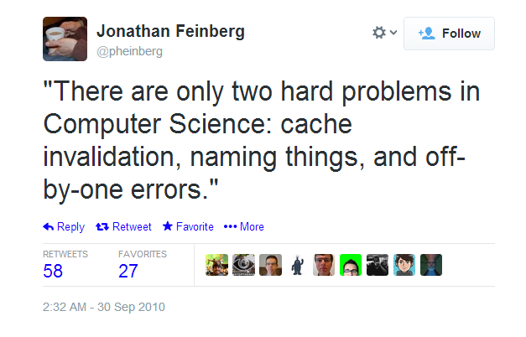

Slide 59
What can bite you here?
  var i, tmp, res = seed;
  for(i=0;i<arr.length;i++){
  if(pred(arr[i])){
  tmp = mapFn(arr[i]);
  res = redFn(res, tmp);
  }
  }
var res = arr.filter(pred).map(mapFn).reduce(redFn, seed);
What if there’s
a hole ?

Slide 60


Slide 61
Same same but different
  arr = [1,2,3]
  arr[4] = 4
  var res = 0;
  for(var i=0;i<arr.length;i++){
  res += arr[i];
  }
  arr.reduce(add, 0)
NaN
10
Notes:
var arr = [1,2,3];
arr[4] = 4
var res = 0;
for(var i=0;i<arr.length;i++){
res += arr[i];
}
alert(res)
alert(arr.reduce(function(ac,i){return ac+i},0))

Slide 62
Just *don’t* do it
Array is a leaky abstraction in Javascript
  It is not a continuum of memory
  It is just a map
Using array’s methods makes your code resilient to
  Copy paste mistakes
  Off by one errors
  Holes in the array

Slide 63
Looping over an array is a code smell in Javascript

Slide 64
Higher order functions
Receive function, return value
Receive value, return function

Slide 65
Receive value, return function
Composing a new function
  Keep the received value in a closure
  Return a new function that uses that value

Slide 66
Fanning out

Slide 67
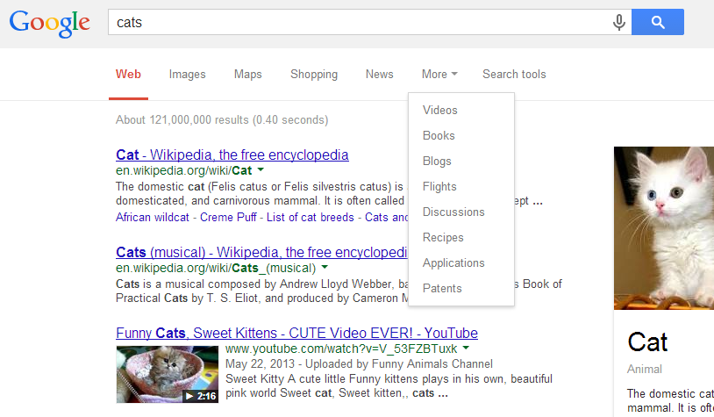

Slide 68
Fan out
Receives several functions
Return a fun-out function that
  For a given input
  Returns all the results of applying the previously given functions on that input

Slide 69
Fan out
function fanOutMaker(/* fns*/){
var fns = arguments;
return function(/* arguments */){
var res = [];
for (var i=0,l=fns.length;i<l;i++)
res.push(fns[i].apply(null, arguments));
}
return res;
}
}

Slide 70
Fan out
Not the same
function fanOutMaker(/* fns*/){
var fns = arguments;
return function(/* arguments */){
var res = [];
for (var i=0,l=fns.length;i<l;i++)
res.push(fns[i].apply(null, arguments));
}
return res;
}
}

Slide 71
Fan out
function fanOutMaker(/* fns*/){
var fns = arguments;
return function(/* arguments */){
var res = [];
for (var i=0,l=fns.length;i<l;i++)
res.push(fns[i].apply(null, arguments));
}
return res;
}
}
Call each of the closured fns with current argument

Slide 72
Today
About functional programming
A little about Javascript
Deep dive into the combination of the two
  Inner functions and closures
  Higher order functions
  Decomplecting calls patterns

Slide 73
Decomplecting calls patterns
A little about functional programming
A little about Javascript
Deep dive into the combination of the two
  Inner functions and closures
  Higher order functions
  Decomplecting calls patterns

Slide 74
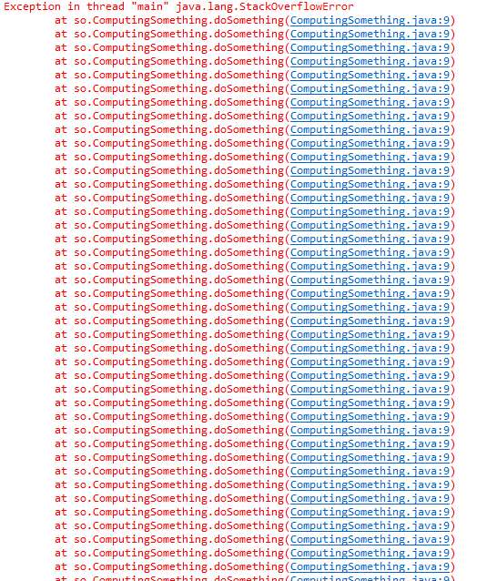
Decomplecting calls patterns

Slide 75
Reclaiming recursion
We were taught that recursion works in theory
  But only there
Some languages provide built-in tail call optimization
  Javascript doesn’t
We can do it by ourselves

Slide 76
Why would you want recursion
Handling recursive structures
  Data formats - Json (or Xml)
  DOM
Data digestion (especially in node.js)
  Graph processing
Sometimes there are tools that do it
Sometimes you need to make the tools

Slide 77
Decomplecting calls patterns
A function call is built of:
  Saying what computation should be done
    What’s the function, what are the arguments
  Telling it to be executed now
What can we gain if we separate it?
  Controlling recursion
  Infinite streams

Slide 78
function someFunc(arg1, arg2){
//do something
// return something
}
someFunc ( a1, a2 )

Slide 79
function someFunc(arg1, arg2){
//do something
// return something
}
someFunc ( a1, a2 )
What computation should be done

Slide 80
function someFunc(arg1, arg2){
//do something
// return something
}
someFunc ( a1, a2 )
Do it now

Slide 81
How to separate?
Wrap the call to someFunc with a function that executes it
Let’s call it ‘continuation’
We can invoke the continuation with different mechanisms
function(){
return someFunc(a1,a2);
}

Slide 82
How to separate?
Wrap the call to someFunc with a function that executes it
Let’s call it ‘continuation’
We can invoke the continuation with different mechanisms to solve different problems
function(){
return someFunc(a1,a2);
}

Slide 83
What kind of problems
Controlling recursion
To infinity, step by step

Slide 84
What kind of problems
Controlling recursion
To infinity, step by step

Slide 85
function factorial (n) {
if(n<2) return n;
return n*factorial(n-1);
}
What’s the problem here?
  Can’t control the depth of the recursion
  How can we make it better?

Slide 86
function factorial (num) {
function fact(accum, n){
if(n === num) return accum;
n += 1;
return fact(accum*n, n);
}
return fact(1, 1);
}
What have we changed?

Slide 87
function factorial (num) {
function fact(accum, n){
if(n === num) return accum;
n += 1;
return fact(accum*n, n);
}
return fact(1, 1);
}
What have we changed?
  Using inner function to compute the factorial
  Moved the recursive call to be in a tail position

Slide 88
function factorial (num) {
function fact(accum, n){
if(n === num) return accum;
n += 1;
return fact(accum*n, n);
}
return fact(1, 1);
}
What have we changed?
  Using inner function to compute the factorial
  Moved the recursive call to be in a tail position
Still, we can’t control the recursion depth

Slide 89
Where’s the problem ?
function factorial (num) {
function fact(accum, n){
if(n === num) return accum;
n += 1;
return fact(accum*n, n);
}
return fact(1, 1);
}

Slide 90
Where’s the problem ?
function factorial (num) {
function fact(accum, n){
if(n === num) return accum;
n += 1;
return fact(accum*n, n);
}
return fact(1, 1);
}

Slide 91
Where’s the problem ?
function factorial (num) {
function fact(accum, n){
if(n === num) return accum;
n += 1;
return fact(accum*n, n);
}
return fact(1, 1);
}
We define the calculation
and say that it should be
performed now

Slide 92
Separate the definition of the call from executing it
function factorial (num) {
function fact(accum, n){
if(n===num) return accum;
n +=1;
return function() { return fact(accum*n, n);};
}
return function() {return fact(1, 1);};
}
What have we changed?
  Made a continuation out of the recursive call
  Still need a mechanism to invoke the continuation

Slide 93
Separate the definition of the call from executing it
function factorial (num) {
function fact(accum, n){
if(n===num) return accum;
n +=1;
return function() { return fact(accum*n, n);};
}
return function() {return fact(1, 1);};
}
What have we changed?
  Made a continuation out of the recursive call
  Still need a mechanism to invoke the continuation

Slide 94
function trampoline (f) {
while(isFunction(f))
f = f();
return f;
}

Slide 95
Separate the definition of the call from executing it
function factorial (num) {
function fact(accum, n){
if(n===num) return accum;
n += 1;
return function() {
return fact(accum*n, n);};
}
return trampoline(
function(){ return fact(1, 1);}
);
}
function trampoline (f) {
while(isFunction(f))
f = f();
return f;
}
What have we changed?
  Used trampoline as a mechanism to invoke the continuation

Slide 96
factorial(5)
trampoline with f(fact(1, 1))
Returning 120 from trampoline
Trampoline
if isFunction(f) – invoke it
otherwise return what it got
f(fact(2, 2))
f(fact(6,3))
f(fact(24,4))
120
fact(1,1)
fact(2,2)
fact(6,3)
…
fact(120,5)
Function call
Return value is a function
Return value is a value

Slide 97
The recipe
Move the recursive call to be in a tail position
  Helper function and accum
  Call the helper function to start
Wrap the recursive call in a continuation
  function() {return <the-recursive-call>;}
  Also the first call to the helper function
Have trampoline around
Call trampoline with the initial continuation

Slide 98
What is it good for?
Controlling recursion
To infinity, step by step

Slide 99
To infinity, step by step
Trampoline computed all the intermediate results till it got to the stop condition
  Immediately called the continuation
Instead, we can make the user control when to call the continuation, and when to stop calling it

Slide 100
How about
Each computation will return an intermediate result and the continuation
Put these two in an object
  Call the result ‘first’
    As it is the first result in the stream starting from this object
  Call the continuation rest
    As it is the way to get to the rest of the stream

Slide 101
function factorialStream () {
function fact(accum, n){
n += 1;
return { first: accum,
rest: function(){return fact(accum*n, n));}
};
return fact(1, 1);
}
factorialStream()
.rest()
.rest()
.rest()
{ first: 1,
rest:F₁ }
{ first: 2,
rest:F₂ }
{ first: 6,
rest:F₃ }
{ first: 24,
rest:F₄ }
…

Slide 102
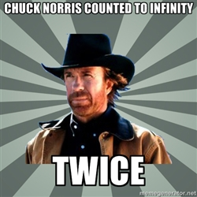

Slide 103
Infinite and lazy streams
What can you do with a stream
  Find specific values
  Make new streams out of streams
    map
    filter
  Make streams out of values
    Repeating , cycling
  Combine streams
    interleaving

Slide 104
Find the n’th element
function dropN(strm, n){
while (n-- > 0 && strm){
strm = strm.rest();
}
return strm;
}
function nth(strm, n) {
return dropN(strm, n-1).first;
}

Slide 105
Infinite and lazy streams
Streams can be passed around and materialize a computation only when needed
See more in this repo: https://github.com/yoavrubin/streams

Slide 106
Summary – key takeaways
In Javascript functions are objects are maps
Closures are your friends
Don’t loop over arrays
Don’t fear recursion

Slide 107
Thank You
@yoavrubin

